Slide 1
Natural Language Processing Introduction

Slide 2



What is NLP?
NLP is a branch of Computer Science where we study about the processing of Text Data and Human Language.
Traditionally, computers are only able to process numerical data.
We map the given text input or language data into the numerical representation of it thereafter we apply machine learning algorithms

Slide 3

Use Cases of NLP
NLP enables the recognition and prediction of diseases based on electronic health records and patient’s own speech.
Determination of customer satisfaction based on reviews left on services
Google uses it in search engine for accurate recommendation
Amazon’s Alexa and Apple’s Siri are an example of intelligent system using NLP
Used in talent recruitment

Slide 4
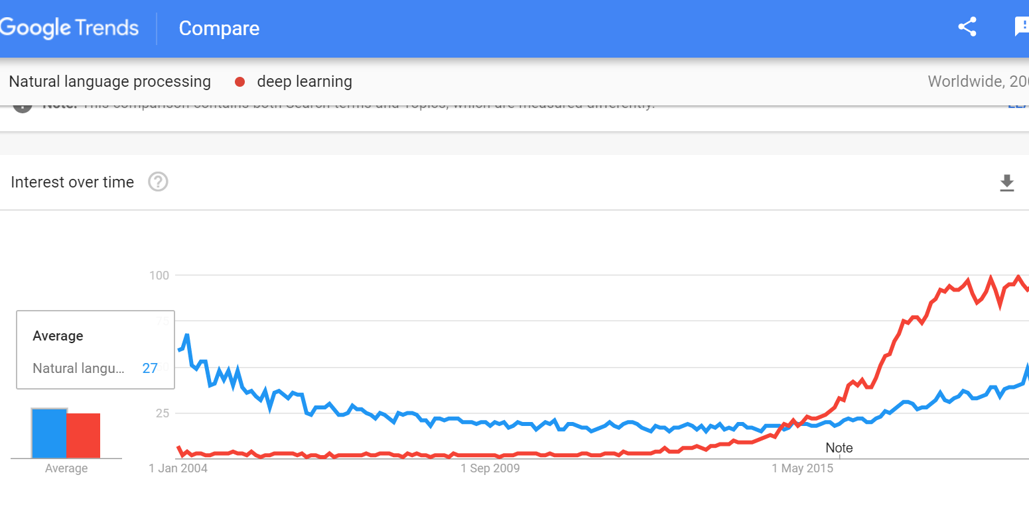

Slide 5
Some Basic NLP Techniques & Applications
Named Entity Recognition (NER)
Tokenization
Stemming and Lemmatization
Bag of Words
Natural language generation
Sentiment Analysis
Sentence Segmentation
Chat Bots

Slide 6
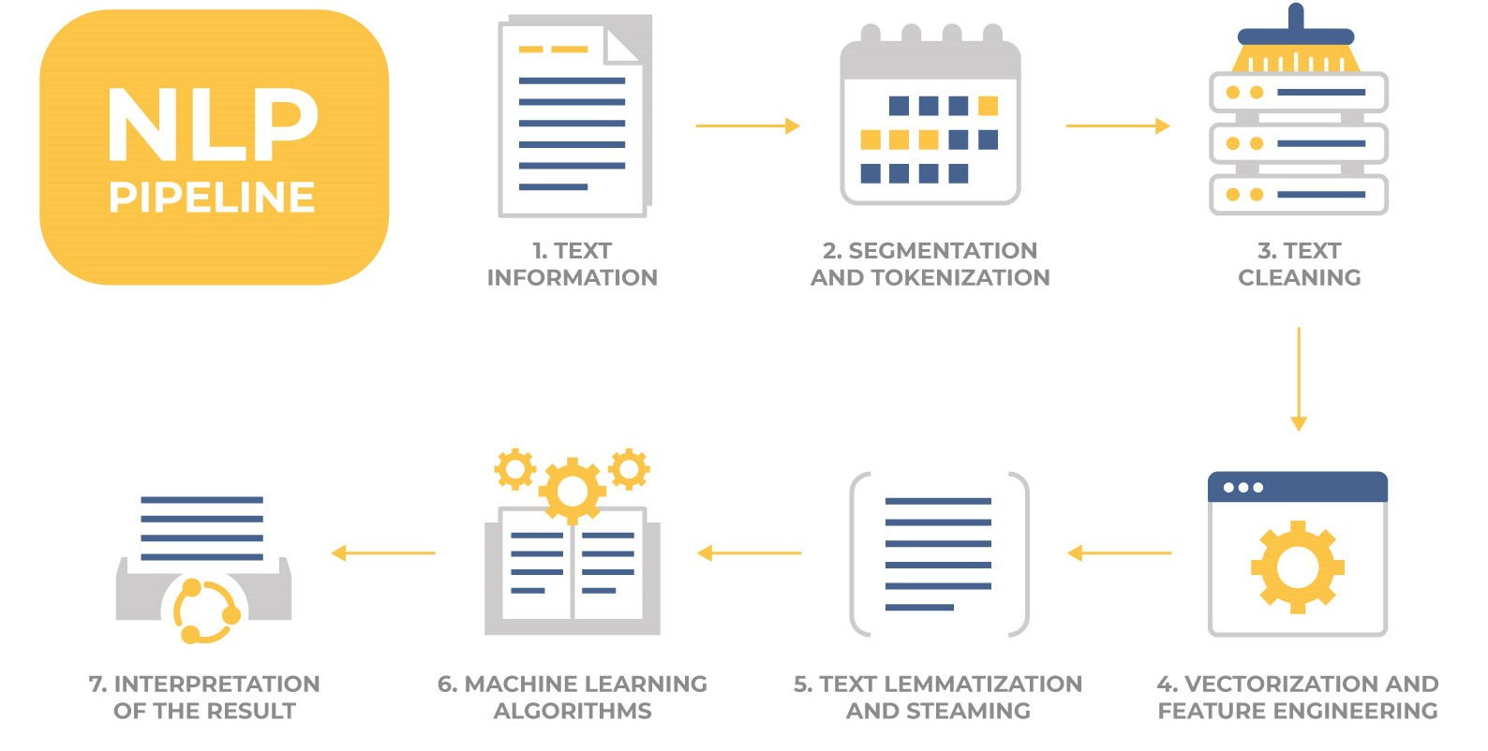

Slide 7
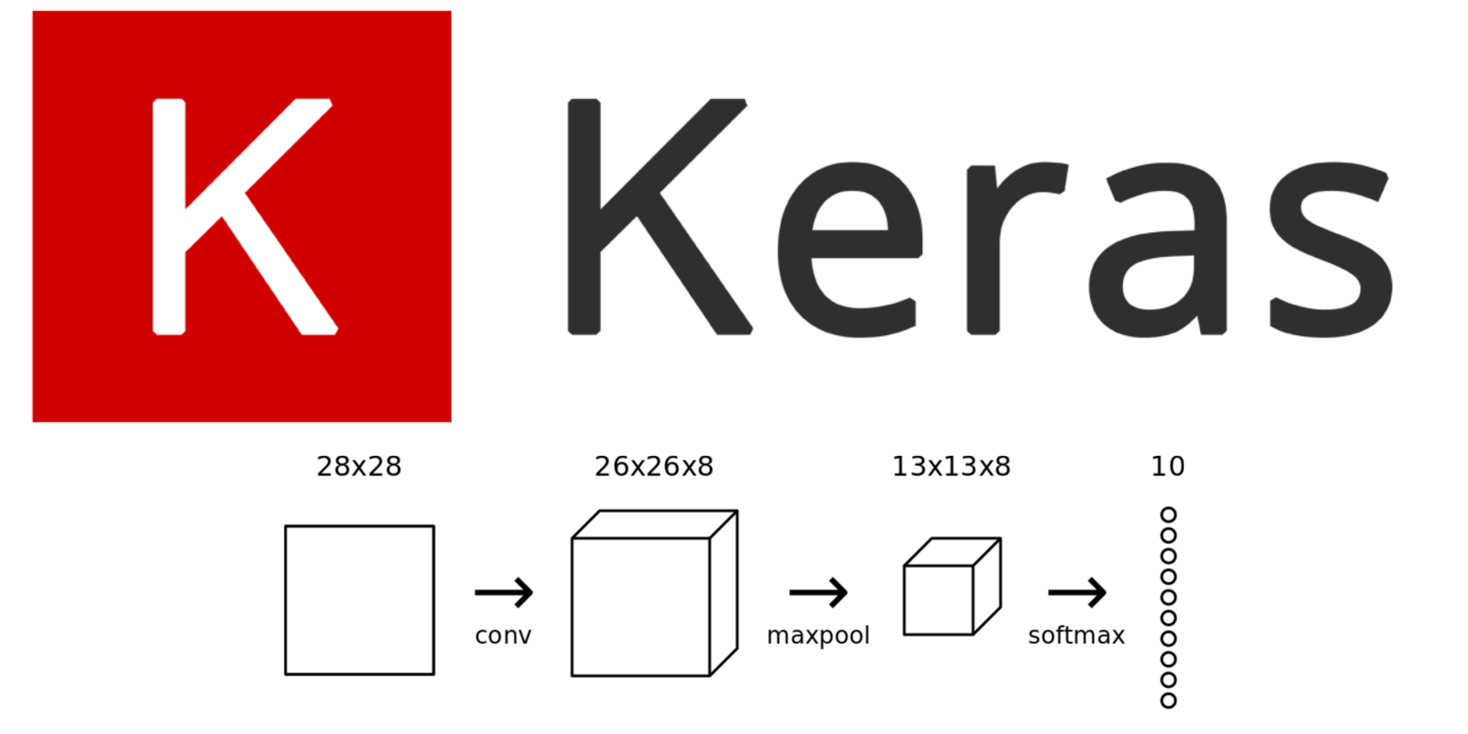


Tools
These are famous tool for text preprocessing

Slide 8
Algorithms Tools
Scikit-Learn
TensorFlow
Keras
Pytorch

Slide 9
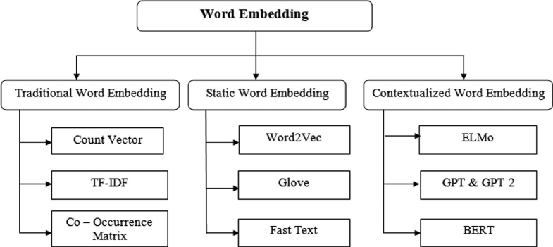
Word Embeddings

Slide 10
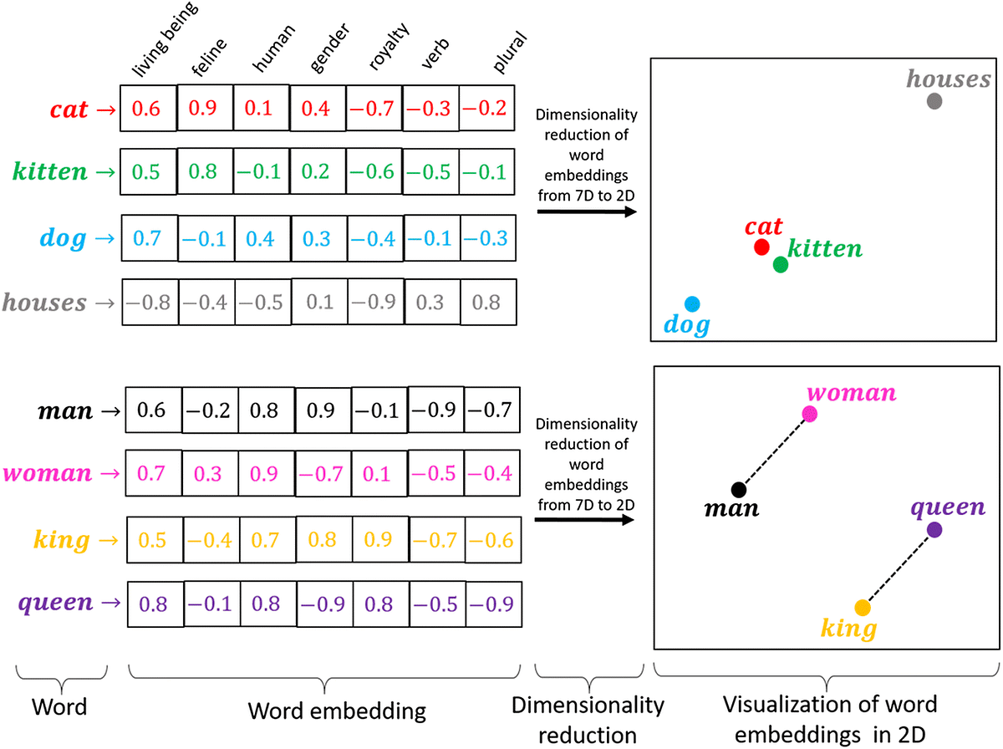
Word Embeddings

Slide 11
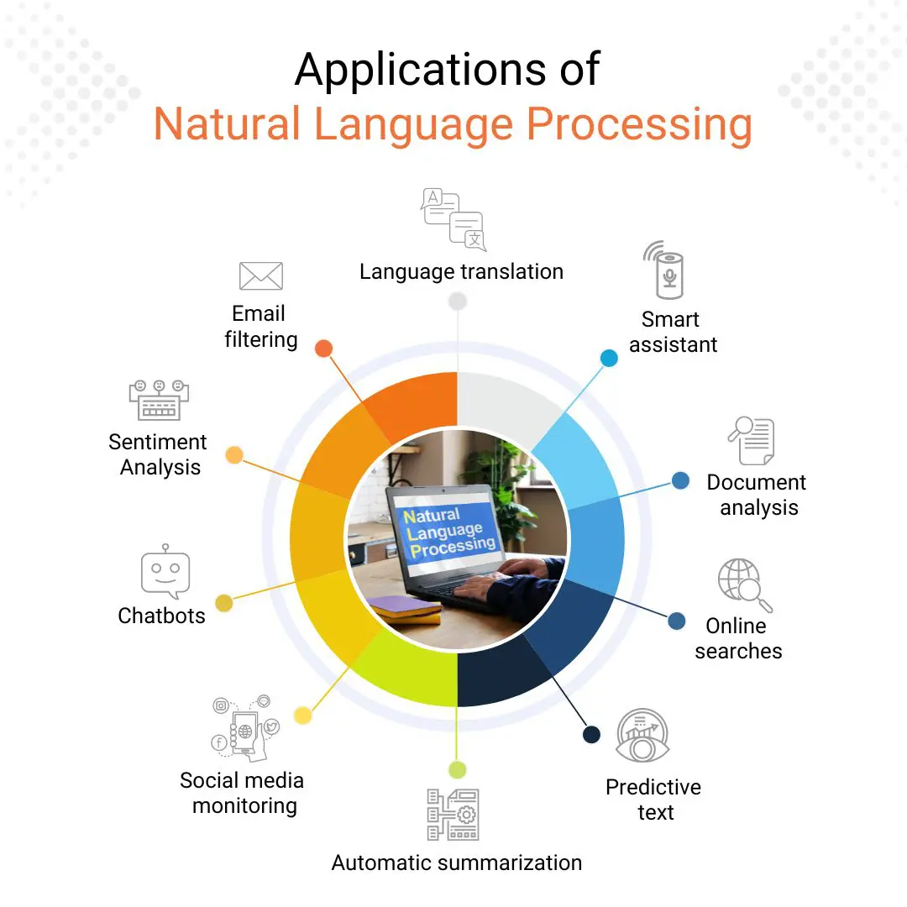
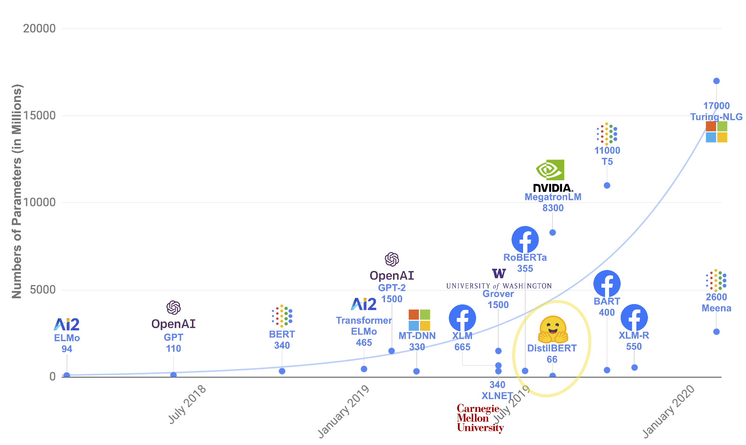
NLP Applications

Slide 12
